Slide 1
SUPPORT VECTOR MACHINES
The support vector machine or SVM framework is currently the most popular approach for “off-the-shelf” supervised learning in modern machine learning technique.
It was introduced by Vapnik in 1992 and has taken off radically since then, principally because it often provides very impressive classification performance on reasonably sized datasets.
Support Vector Machine is used for Classification as well as Regression problems. However, primarily, it is used for Classification problems in Machine Learning.
This approach is fairly simple: we choose a kernel and then for given data, assemble the relevant quadratic problem and its constraints as matrices, and then pass them to the solver, which finds the decision boundary and necessary support vectors for us.

Slide 2
Cont.,
The goal of the SVM algorithm is to create the best line or decision boundary that can be segregate n-dimensional space into classes.
So that we can easily put the new data point in the correct category in the future. This best decision boundary is called a hyperplane.
SVM chooses the extreme points/vectors that help in creating the hyperplane. These extreme cases are called as support vectors, and hence algorithm is termed as Support Vector Machine.
If you don’t have any specialized prior knowledge about a domain, then the SVM is an excellent method to try first.

Slide 3
Properties of SVM
There are three properties that make SVMs attractive:
SVMs construct a maximum margin separator.
SVMs create a linear separating hyperplane, but they have the ability to embed the data into a higher-dimensional space.
SVMs are a nonparametric method—they retain training examples and potentially need to store them all., using the so-called kernel trick.

Slide 4
Cont.,
Note: A nonparametric model is one that cannot be characterized by a bounded set of parameters.
For example, suppose that each hypothesis we generate simply retains within itself all of the training examples and uses all of them to predict the next example.
Such a hypothesis family would be nonparametric because the effective number of parameters is unbounded it grows with the number of examples.
You could say that SVMs are successful because of one key insight and one neat trick.

Slide 5
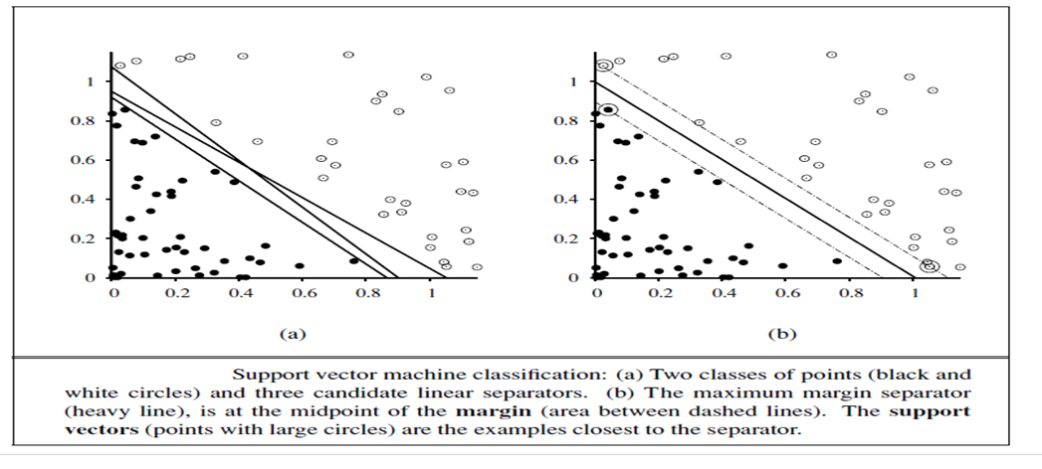
Two Different Categories That Are Classified Using A Decision Boundary Or Hyperplane

Slide 6
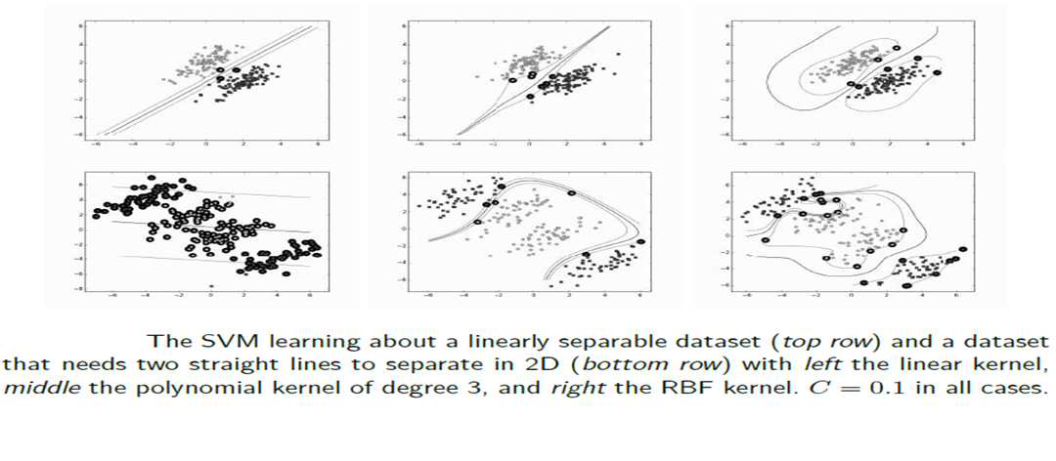
Cont.,

Slide 7
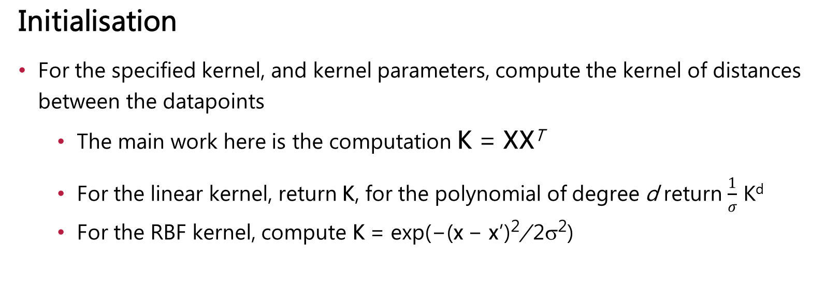
The Support Vector Machine Algorithm
Initialisation
For the specified kernel, and kernel parameters, compute the kernel of distances between the datapoints
The main work here is the computation K = XX^{T}
For the linear kernel, return K, for the polynomial of degree d return $\frac{1}{σ}$ K^{d}
For the RBF kernel, compute K = exp(−(x − x’)²/ 2σ²)

Slide 8

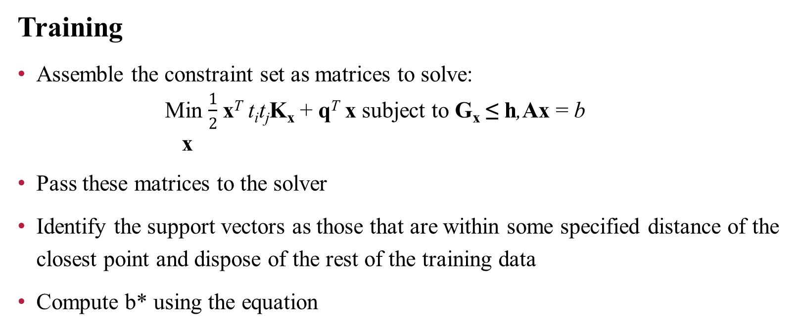
Cont.,
Training
Assemble the constraint set as matrices to solve:
Min $\frac{1}{2}$ x^{T} t_{i}t_{j}K_{x} + q^{T} x subject to G_{x} ≤ h,Ax = b
x
Pass these matrices to the solver
Identify the support vectors as those that are within some specified distance of the closest point and dispose of the rest of the training data
Compute b* using the equation

Slide 9
Cont.,
Classification
For the given test data z, use the support vectors to classify the data for the relevant kernel using:
Compute the inner product of the test data and the support vectors
Perform the classification as , returning either the label (hard classification) or the value (soft classification)

Slide 10
Multi-Class Classification
The SVM only works for two classes. This might seem like a major problem, but with a little thought it is possible to find ways around the problem.
For the problem of N-class classification, you train an SVM that learns to classify class one from all other classes, then another that classifies class two from all the others. So for N-classes, we have N SVMs.
This still leaves one problem: how do we decide which of these SVMs is the one that recognises the particular input?
The answer is just to choose the one that makes the strongest prediction, that is, the one where the basis vector input point is the furthest into the positive class region. It might not be clear how to work out which is the strongest prediction.

Slide 11

SVM Regression
Perhaps rather surprisingly, it is also possible to use the SVM for regression. The key is to take the usual least-squares error function (with the regulariser that keeps the norm of the weights small):
and transform it using what is known as an ∈-insensitive error function (E∈ ) that gives 0 if the difference between the target and output is less than ∈ (and subtracts ∈ in any other case for consistency). The reason for this is that we still want a small number of support vectors, so we are only interested in the points that are not well predicted.

Slide 12
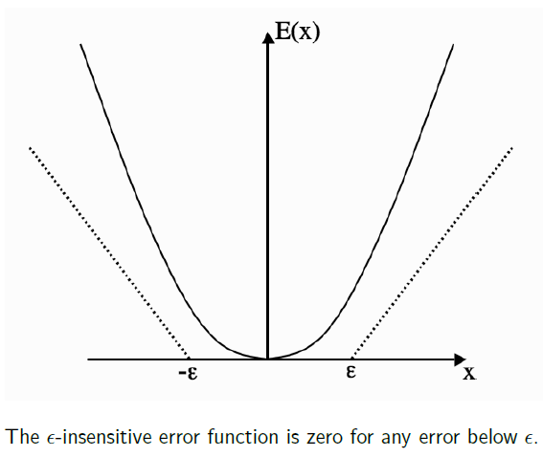
The ∈-insensitive error function is zero for any error below ∈

